Slide 1

Artificial Intelligence In Medicine
By: Alec Meyer

Slide 2
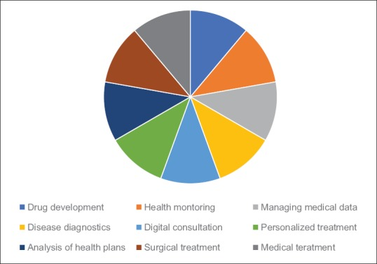
What is Artificial Intelligence in medicine?

Slide 3
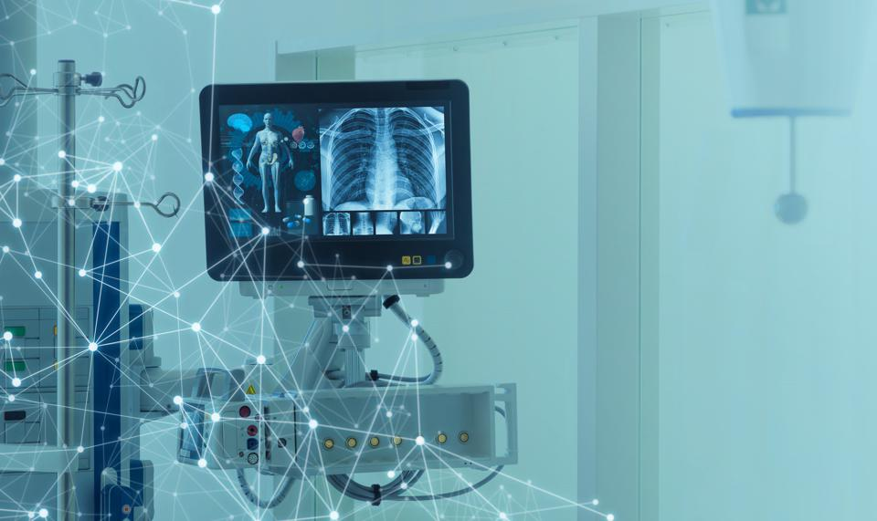
Accuracy of diagnoses
AI: 82%
Doctor Avg: 72%

Slide 4

Patient Wait times
Low-risk patients
High-risk patients

Slide 5
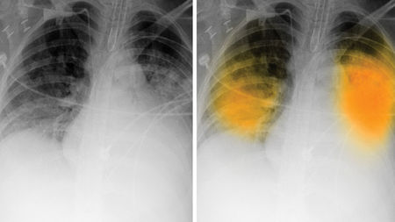
Artificial intelligence implementation
Radiology

Slide 6


Radiology
False Positives

Slide 7
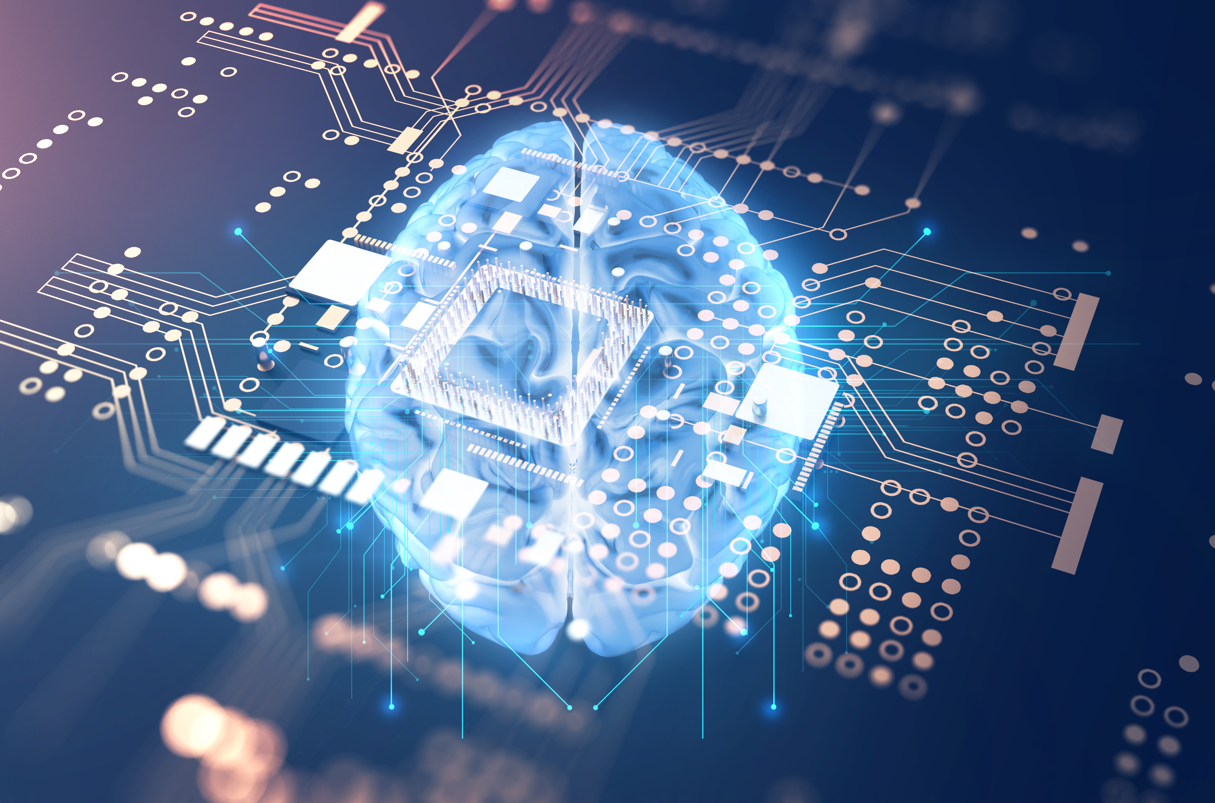
Final Thoughts

Slide 8
Work cited
Sparrow, Robert, and Joshua Hatherley. “High Hopes for ‘Deep Medicine’? AI, Economics, and the Future of Care.” Hastings Center Report, vol. 50, no. 1, Jan. 2020, pp. 14–17. EBSCOhost, doi:10.1002/hast.1079.
Nadin, Mihai. “Aiming AI at a Moving Target: Health (or Disease).” AI & Society, vol. 35, no. 4, Dec. 2020, pp. 841–849. EBSCOhost, doi:10.1007/s00146-020-00943-x.
Amisha et al. “Overview of artificial intelligence in medicine.” Journal of family medicine and primary care vol. 8,7 (2019): 2328-2331. doi:10.4103/jfmpc.jfmpc_440_19
Sagar Kulkarni, Nuran Seneviratne, Mirza Shaheer Baig, Ameer Hamid Ahmed Khan, Artificial Intelligence in Medicine: Where Are We Now?, Academic Radiology, Volume 27, Issue 1, 2020, Pages 62-70, ISSN 1076-6332, https://doi.org/10.1016/j.acra.2019.10.001

